Slide 1
Call Analysis Dashboard
Name: Sanga Laxmi
Tools: Power Bi

Slide 2
Objective:
Analyze call performance and product sales.
Track trends and efficiency across customers (Agent Name).
Provide both overview and detailed insights for decision-making

Slide 3
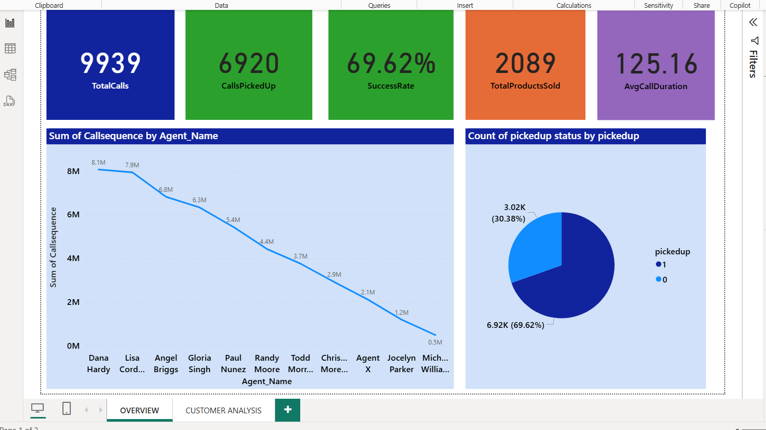
Page1: Overview
Key Insights:
Total Calls, Calls Picked Up, and Total Products Sold give a quick summary.
Success Rate indicates call efficiency.
Trend over Call Sequence shows how calls/products change over time.
Pie chart shows distribution of picked vs not picked calls.

Slide 4
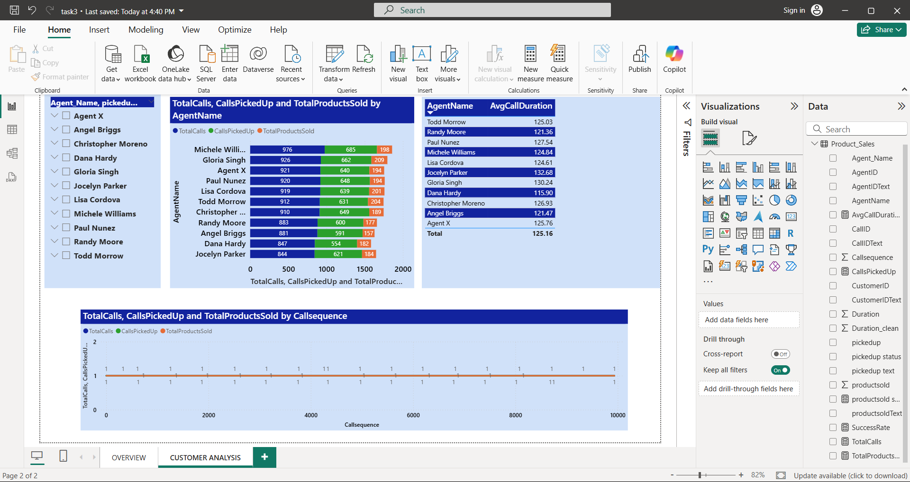
Page2: Customer Analysis
Key Insights:
Comparison of calls, picked calls, and products sold by customer (Agent Name).
Average Call Duration varies across customers.
Slicers allow filtering by Agent Name, Picked Up, Products Sold.

Slide 5
conclusion
The dashboard provides a comprehensive overview of call performance, product sales, and customer efficiency.
KPI cards highlight total calls, picked-up calls, success rate, total products sold, and average call duration for quick decision-making.
Time-series analysis using Call Sequence shows trends over calls, helping identify peak activity periods and efficiency patterns.
Customer-level insights (Agent Name) reveal top contributors and variations in call performance and product sales.
Interactive slicers and charts allow dynamic filtering, enabling detailed exploration by customer or call outcome.
Overall, the dashboard serves as an actionable tool for managers to monitor performance, optimize call strategies, and focus on high-value customers.

Slide 6
Thank You

